Slide 1

Predicting Loan Approval Status Using Machine Learning:
A Comparative Study of Classification Models for Enhanced Credit Scoring in Banking
Done By: Fouzia Kouser

Slide 2
About me
I have completed my graduation in B.Sc Mathematics, Statistics and Computer Science, which has equipped me with a diverse skill set essential for Data Science . I'm passionate about Data Science because I enjoy solving problems and uncovering valuable insights from Data . The prospect of diving into large datasets, identifying patterns, and making informed decisions excites me. As a fresher in the field of Data Science, I am motivated to apply my skills and learn continuously in this dynamic field.
LinkedIn:
https://www.linkedin.com/in/fouzia-kouser
GitHub:
https://github.com/fouzia2305

Slide 3
Problem Statement:
In the banking sector, credit risk management is crucial for ensuring financial stability and minimizing losses. With the increasing volume of loan applications, banks face the challenge of accurately predicting whether a borrower will default on their loan payments. This prediction is essential for making informed lending decisions and reducing the bank's non-performing assets.
Objective:
The objective of this project is to develop a predictive model that can accurately classify loan applicants into default and non-default categories based on various features such as age, income, loan amount, loan intent, home ownership, etc. By leveraging machine learning techniques, we aim to assist banks in identifying potential defaulters early in the loan application process, thereby mitigating credit risk and improving loan portfolio performance.

Slide 4
Data:
The dataset provided contains information about loan applicants, including the following features:
person_age: Age of the applicant
person_income: Annual income of the applicant
person_home_ownership: Home ownership status of the applicant
person_emp_length: Employment length of the applicant (in years)
loan_intent: Purpose of the loan
loan_grade: Grade assigned to the loan
loan_amnt: Loan amount requested

Slide 5
loan_amnt: Loan amount requested
loan_int_rate: Interest rate on the loan
loan_percent_income: Percentage of income dedicated to loan payments
cb_person_default_on_file: Historical default status of the applicant
cb_person_cred_hist_length: Credit history length of the applicant
The 'loan_status' column is the target variable, as it indicates whether a loan application was approved (0) or not (1).

Slide 6
Methodology
The analysis of the dataset revealed the following insights and observations:
Basic Information and Data Preprocessing
Shape of Data: The combined dataset has 32,581 rows and 12 columns.
Missing Values: Initial check revealed 895 missing values for 'person_emp_length' and 3,116 missing values for 'loan_int_rate'. Imputation involved filling missing 'person_emp_length' values with the median (5.0) and missing 'loan_int_rate' values with the median (11.0)..
Duplicates: Duplicate rows were identified and removed from the dataset.
Handling Outliers: Replaced higher outliers with the upper boundary value based on the Interquartile Range (IQR) method for columns 'person_age', 'person_income', 'person_emp_length', 'loan_amnt', 'loan_int_rate', 'loan_percent_income', and 'cb_person_cred_hist_length'. Reducing the impact of outliers helps in stabilizing statistical analysis and improving model performance.

Slide 7
Unique Values of Categorical Columns:
person_home_ownership: 'RENT', 'MORTGAGE', 'OWN', 'OTHER’
loan_intent: 'VENTURE', 'EDUCATION', 'MEDICAL', 'PERSONAL', 'DEBTCONSOLIDATION', 'HOMEIMPROVEMENT’
loan grade: 'B', 'A', 'C', 'D', 'E', 'F', 'G’
cb_person_default_on_file: 'N', 'Y’
These unique values provide insights into the diversity and distribution of categorical variables within the dataset.

Slide 8
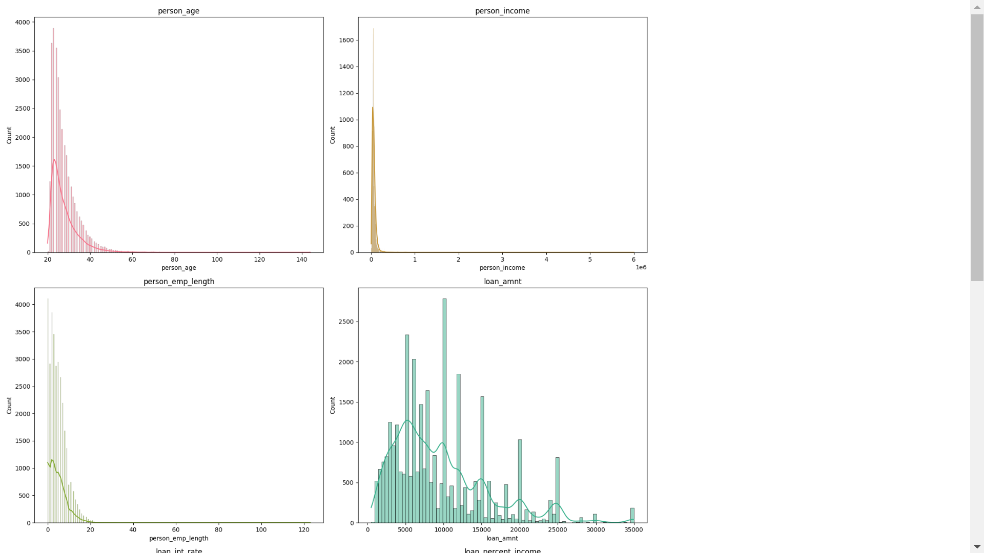
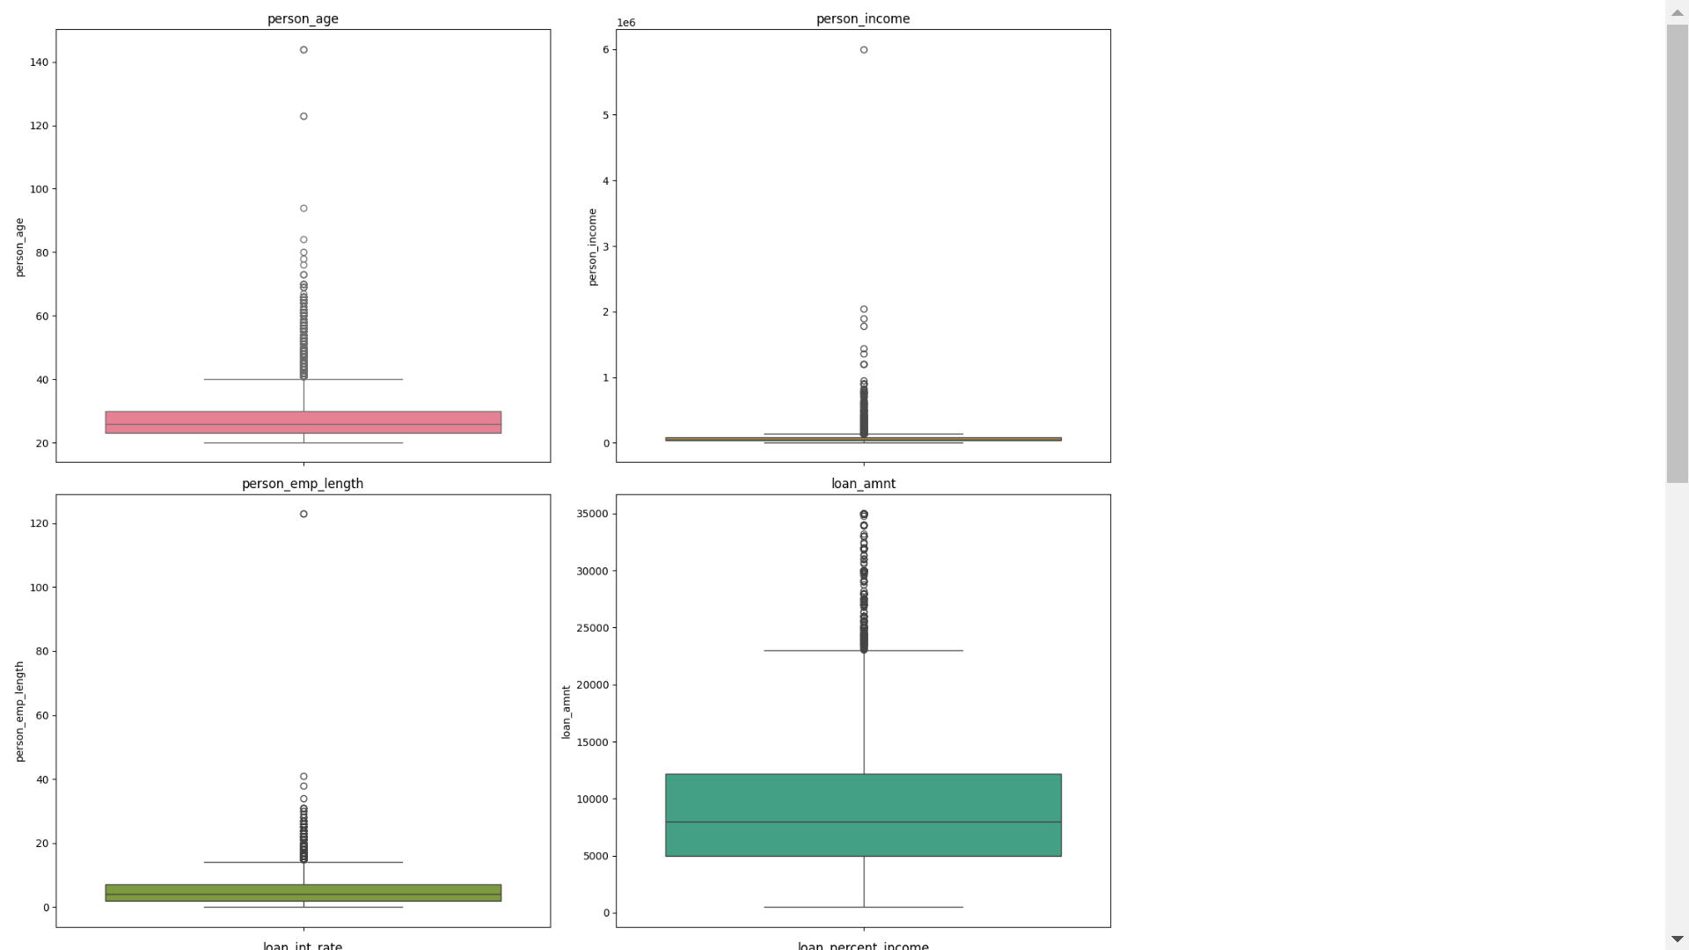
Exploratory Data Analysis
Univariate Analysis on Numerical Columns
1.person_age:
Mean Age: The average age of loan applicants is approximately 28 years.
Range: Ages range from 20 to 144 years, with a significant maximum value suggesting potential outliers.
Distribution: The histogram suggests a relatively normal distribution, with a slight right skewness.

Slide 9
2.person_income:
Mean Income: The average income of loan applicants is around $66,092.
Range: Incomes vary widely, from $4,000 to $6,000,000, indicating potential outliers.
Distribution: The histogram shows a right-skewed distribution, with most applicants having lower incomes.

Slide 10
3.loan_amnt:
Mean Loan Amount: The average loan amount is approximately $9,594.
Range: Loan amounts range from $500 to $35,000, with potential outliers at the upper end.
Distribution: The histogram shows a right
-skewed distribution, with most loans being smaller amounts.

Slide 11
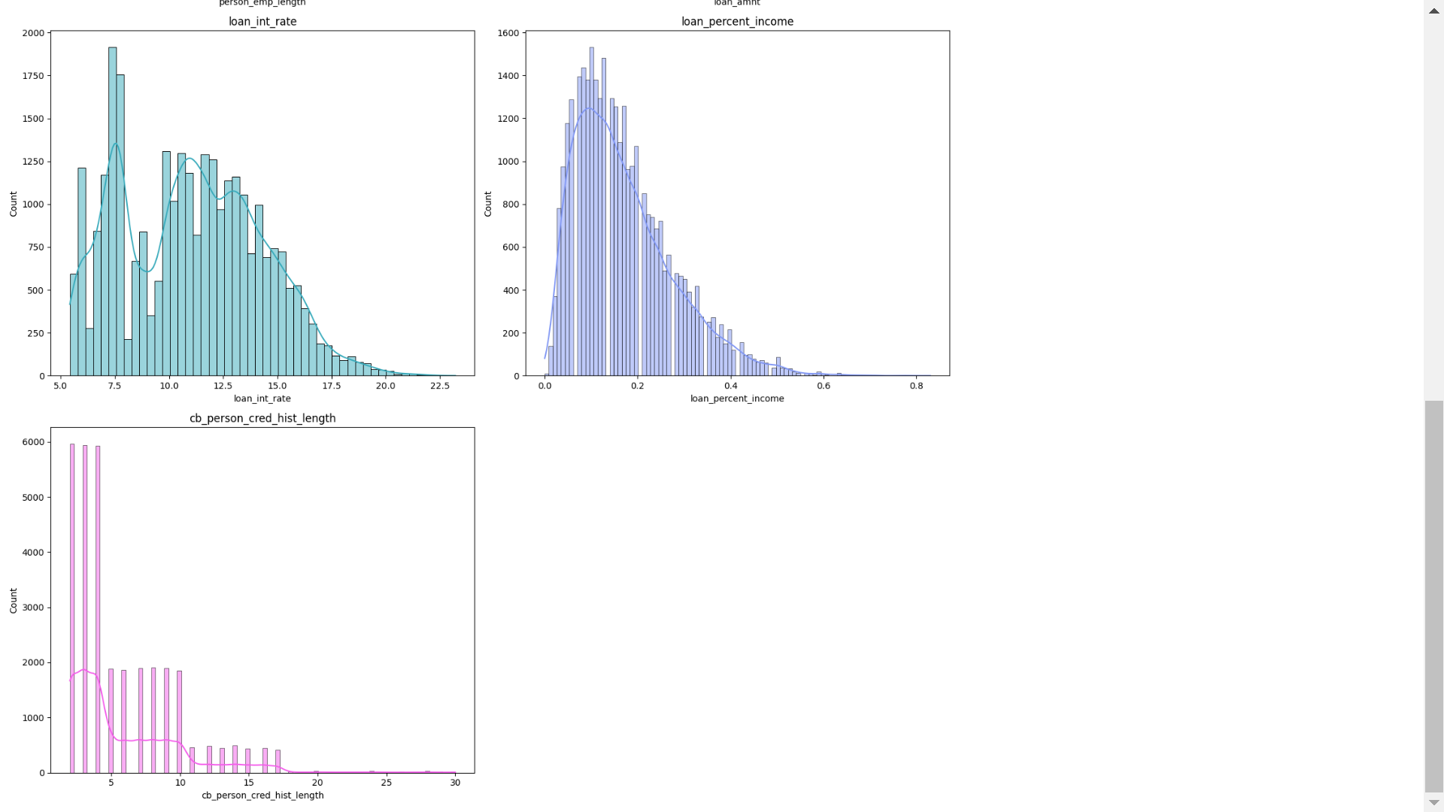
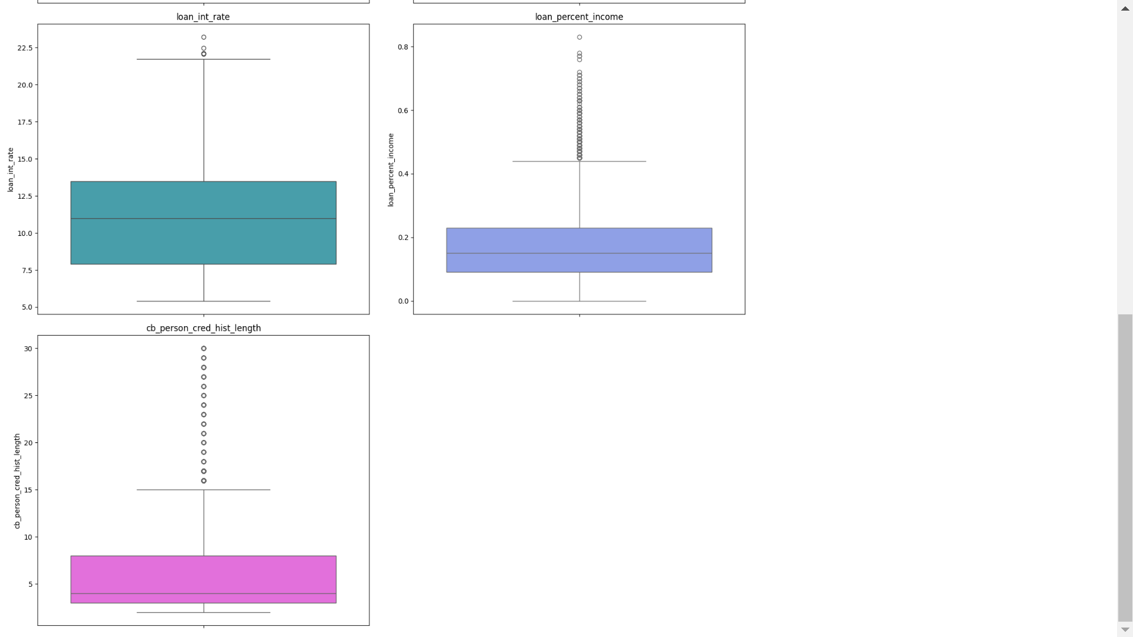
4.loan_int_rate:
Mean Interest Rate: The average interest rate is around 11%.
Range: Interest rates range from 5% to 23%, with some potential outliers at the upper end.
Distribution: The histogram suggests a relatively normal distribution, with some variation in interest rates.

Slide 12
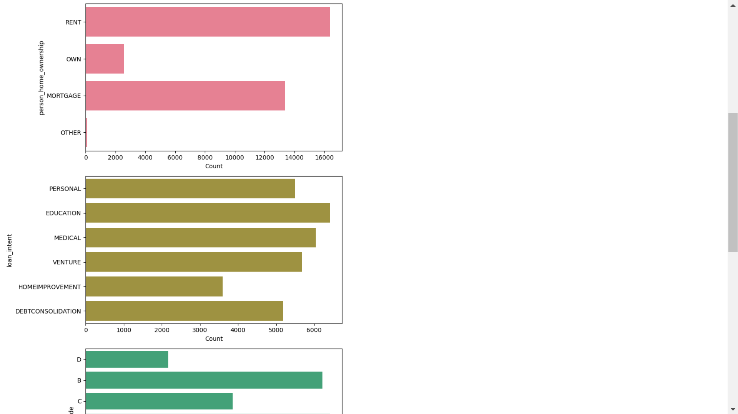
Univariate Analysis on Categorical Columns
OBSERVATIONS:
person_home_ownership:
Majority of loan applicants (approximately 50.52%) are renters, followed by individuals with mortgages (41.24%). Only a small percentage of applicants own their homes (7.91%), while others fall into the "OTHER" category (0.33%).
loan_intent:
The most common loan intent is for education purposes (19.78%), followed by medical (18.64%) and venture (17.53%) purposes. Personal loans (16.96%) and debt consolidation (16.01%) are also popular intents, while home improvement loans (11.09%) are less frequent.

Slide 13
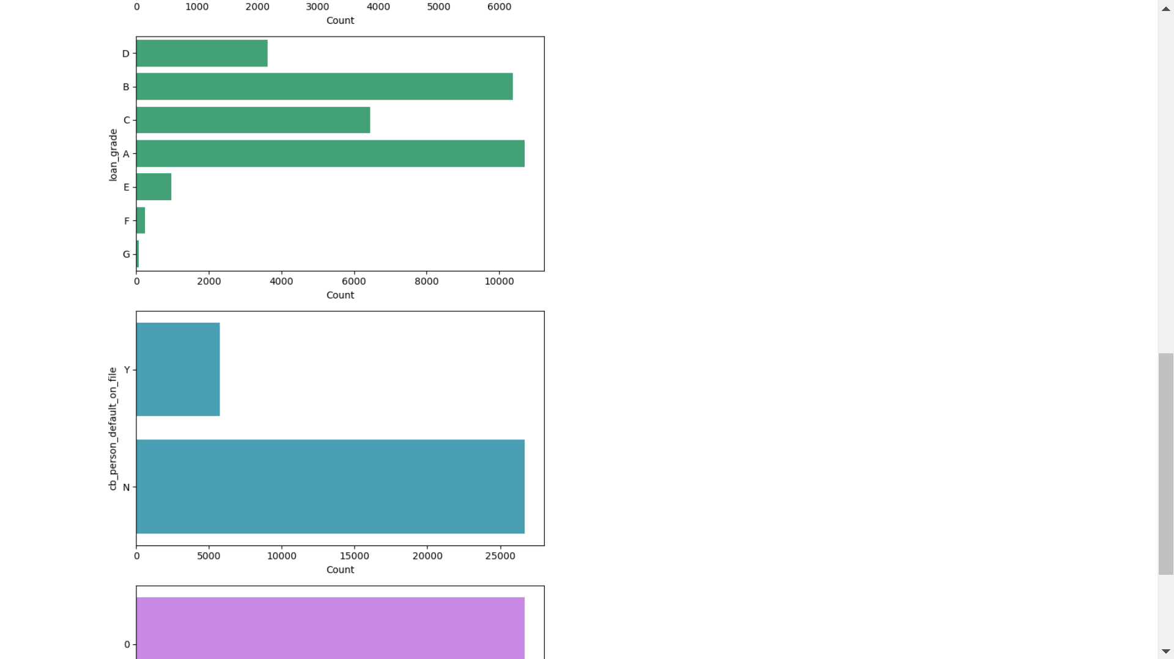
loan_grade:
The majority of loans are assigned grade A (33.02%), indicating lower risk. Grades B and C follow, representing 32.04% and 19.86% of loans, respectively. Grades D, E, F, and G have progressively lower proportions, indicating higher risk loans.
cb_person_default_on_file:
Most loan applicants (82.32%) do not have a history of defaulting on loans (denoted by 'N'). A smaller proportion (17.68%) have a history of defaulting (denoted by 'Y').

Slide 14
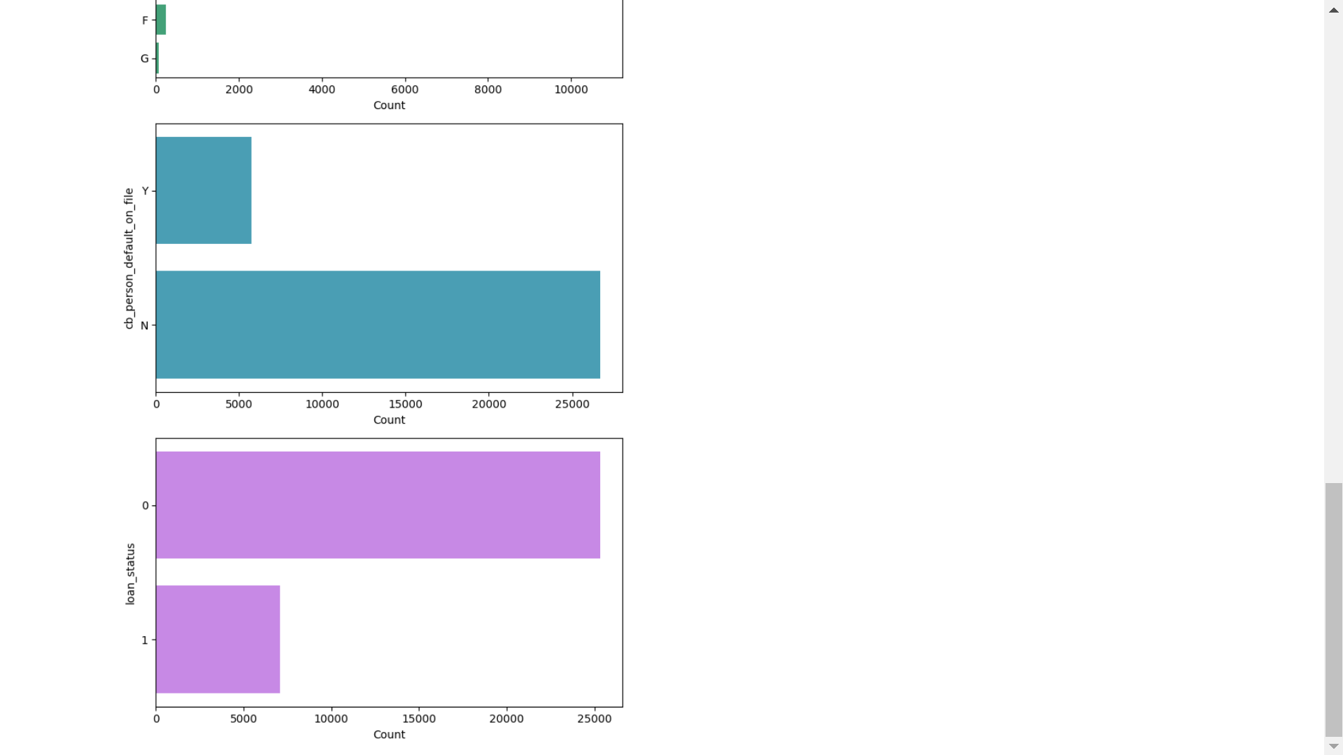
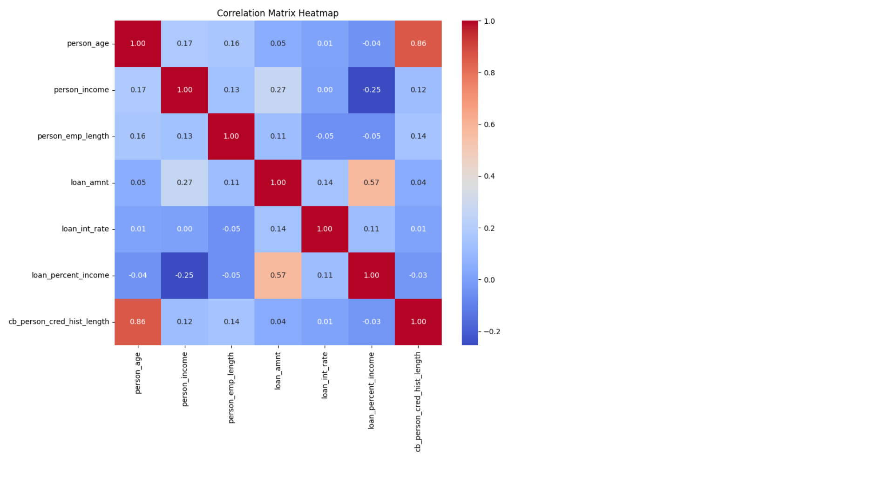
loan_status:
The dataset contains both defaulted (21.87%) and non-defaulted (78.13%) loans. This indicates that approximately 22% of the loans in the dataset have defaulted.
Bivariate Analysis
Correlation Matrix:

Slide 15
Observations
High Correlation Between 'person_age' and 'cb_person_cred_hist_length’:
Correlation coefficient: 0.86
Observation: Older individuals tend to have longer credit histories.
Moderate Correlation Between 'loan_amnt' and 'loan_percent_income’:
Correlation coefficient: 0.57
Observation: Higher loan amounts generally constitute a larger percentage of the applicant's income.
Moderate Correlation Between 'person_income' and 'loan_amnt’:
Correlation coefficient: 0.27
Observation: Higher income individuals tend to apply for larger loan amounts.
Moderate Negative Correlation Between 'person_income' and 'loan_percent_income’:
Correlation coefficient: -0.25
Observation: As the income of individuals increases, the percentage of income taken up by the loan amount decreases.

Slide 16
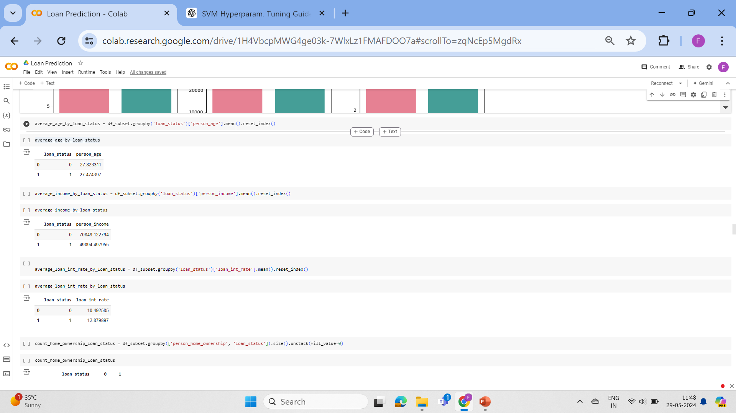
Group By

Slide 17
Observations Based on Loan Status:
Average Age by Loan Status:
Approved (0): 27.82 years
Not Approved (1): 27.47 years
Observation: Loan applicants who got their loans approved tend to be slightly older on average compared to those who did not.
Average Income by Loan Status:
Approved (0): $70,849.12
Not Approved (1): $49,094.50
Observation: Applicants with higher incomes are more likely to have their loans approved.
Average Loan Interest Rate by Loan Status:
Approved (0): 10.49%
Not Approved (1): 12.88%
Observation: Approved loans tend to have lower interest rates compared to loans that were not approved.
These observations highlight the key differences in age, income, and interest rates between applicants who got their loans approved and those who did not.

Slide 18
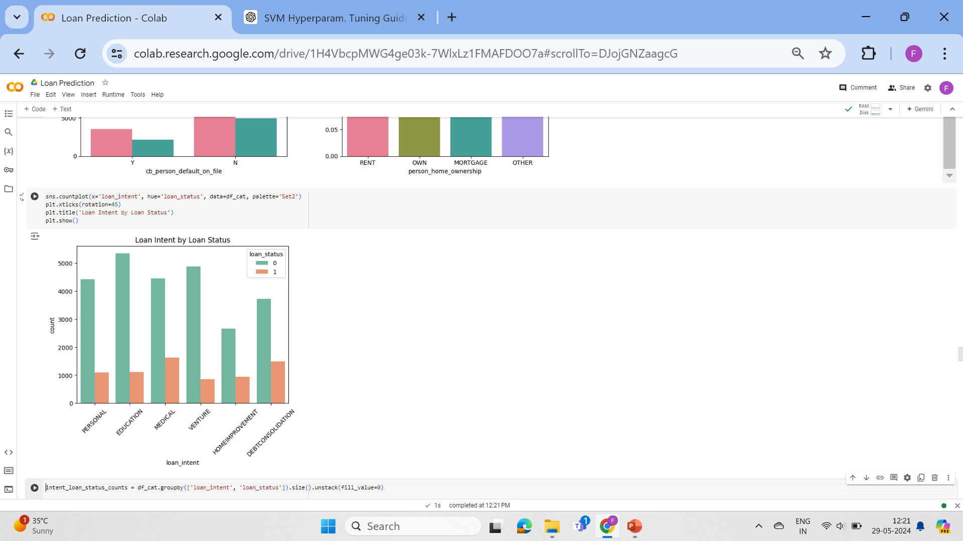
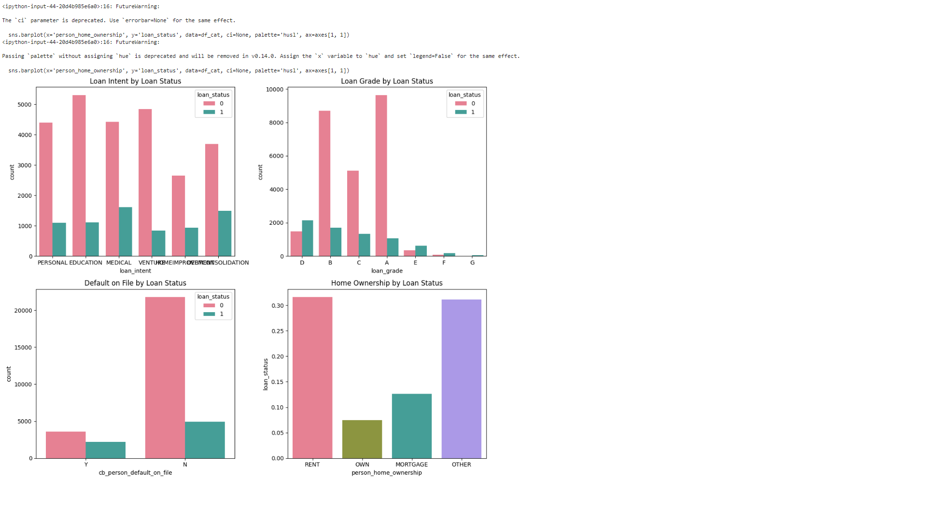
Observations Based on Various Factors:
Loan Intent by Loan Status:
Loan intents related to "VENTURE" and "EDUCATION" have the highest approval rates, while "DEBTCONSOLIDATION" and "MEDICAL" have relatively lower approval rates.
Loan Grade by Loan Status:
Higher loan grades (A and B) have significantly higher approval rates, whereas lower grades (D, E, F, G) have much higher rejection rates.

Slide 19
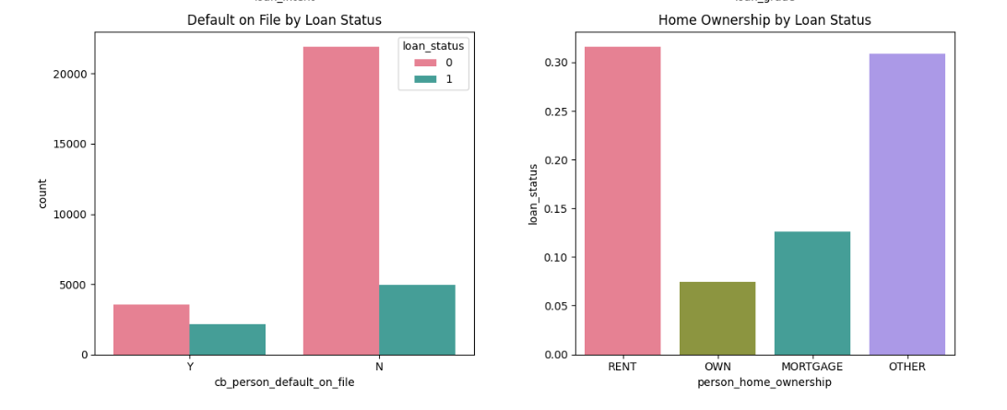
Default on File by Loan Status:
Applicants with no previous defaults have a higher approval rate compared to those with defaults on file
Home Ownership by Loan Status Proportions:
The distribution of loan statuses across different home ownership types indicates that applicants with "MORTGAGE" or "OWN" are less common among those with loan statuses compared to those who "RENT" or fall under "OTHER".
These observations help in understanding the relationship between loan status and various applicant characteristics, providing insights into approval tendencies and risk factors.

Slide 20
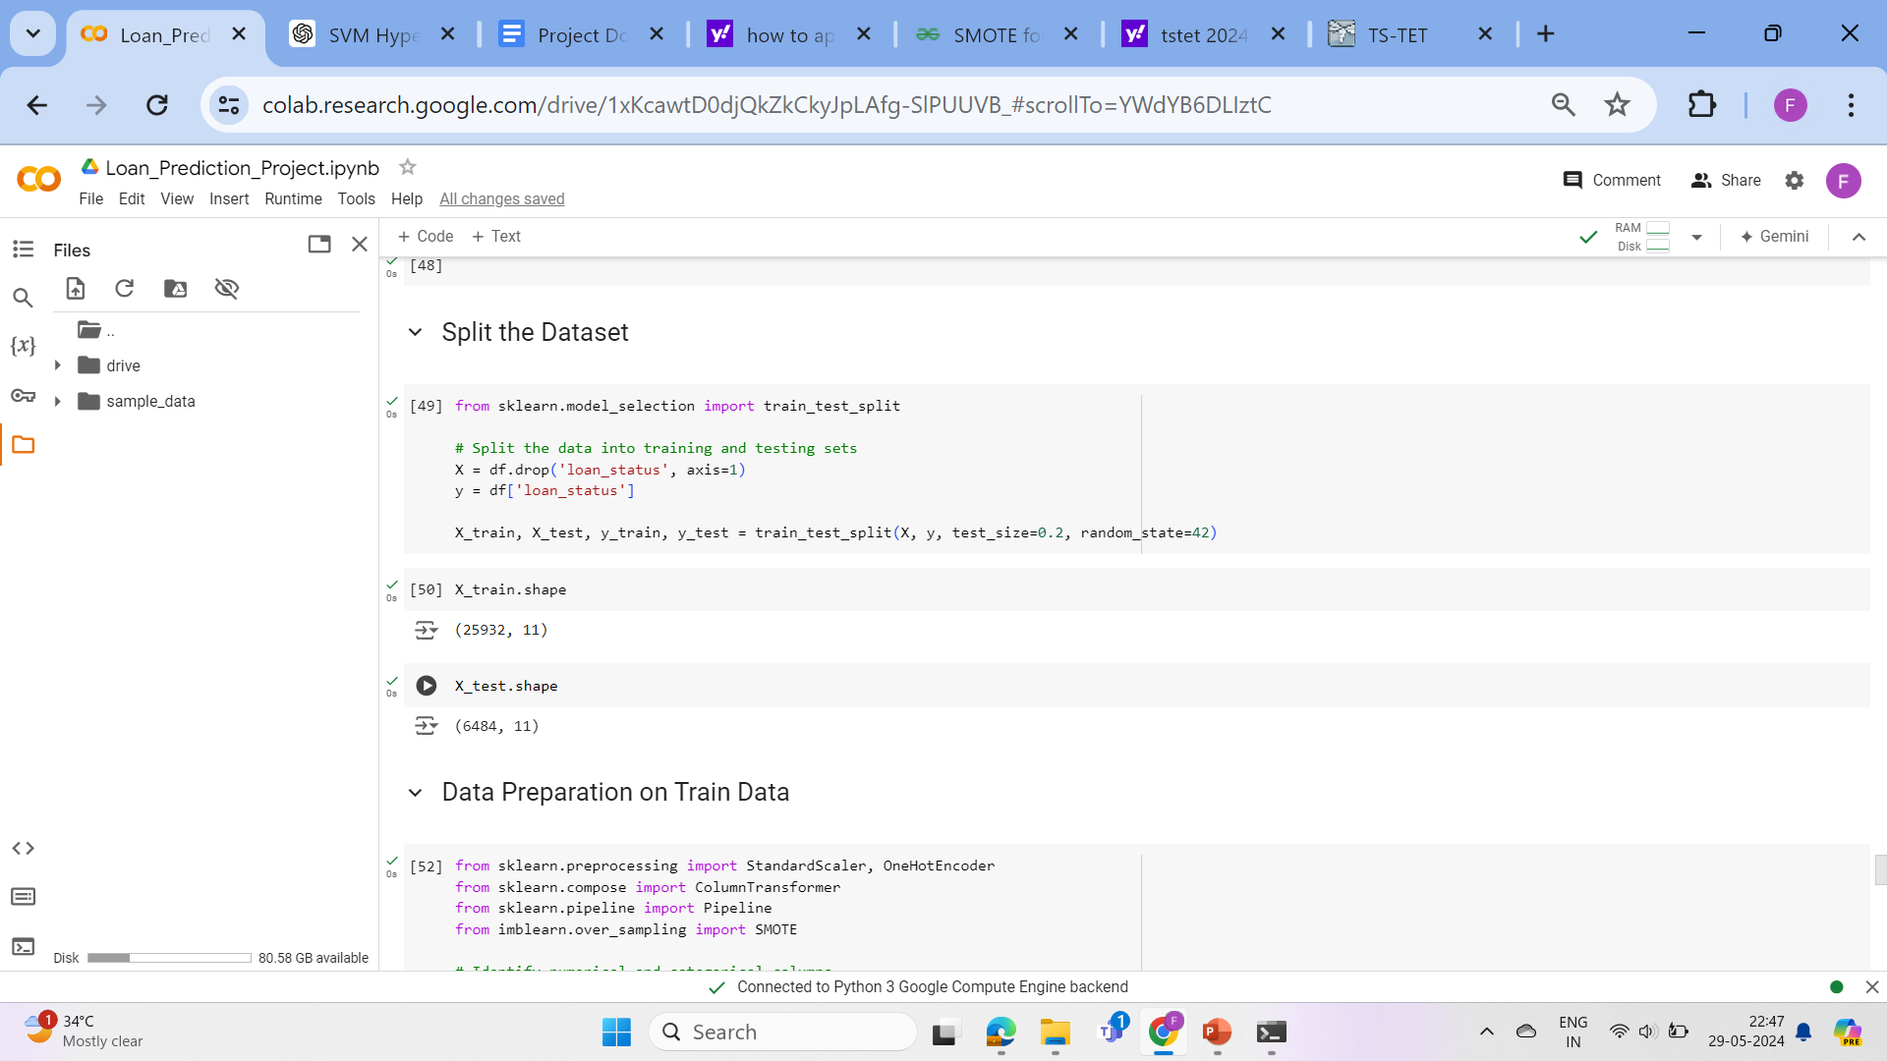
Splitting the Dataset
We start by splitting the dataset into training and testing sets using the train_test_split function from sklearn.model_selection. Here, 80% of the data is used for training, and 20% is reserved

Slide 21
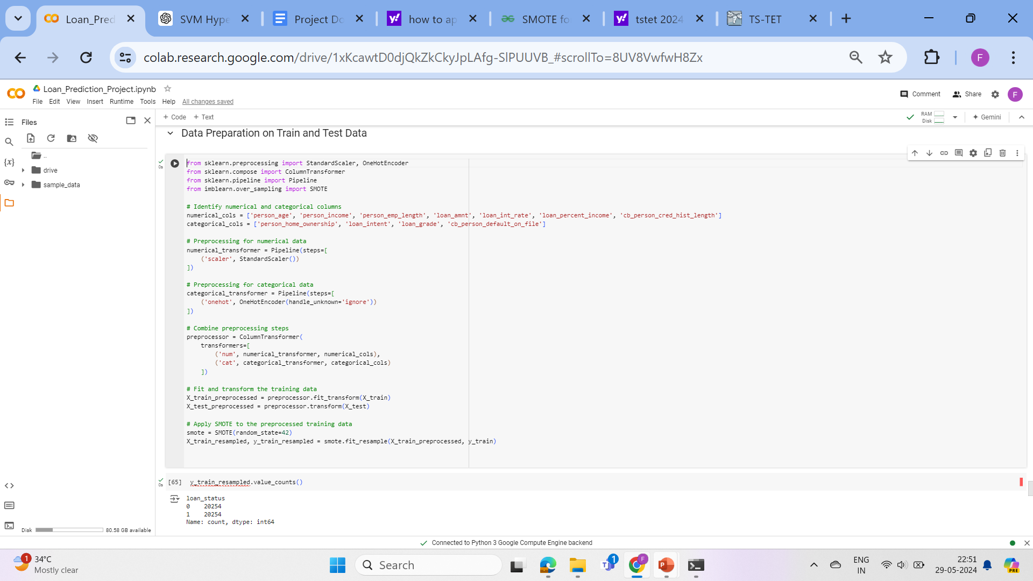
Preprocessing Data

Slide 22
Before training the models, we preprocess the data. This involves:
Identifying Numerical and Categorical Columns: We define lists of numerical and categorical columns in the dataset.
Preprocessing for Numerical Data: We use a StandardScaler to standardize the numerical features.
Preprocessing for Categorical Data: We use a OneHotEncoder to convert categorical features into one-hot encoded vectors, handling unknown categories.
Combining Preprocessing Steps: We use a ColumnTransformer to apply the preprocessing steps to the respective columns.
Handling Class Imbalance with SMOTE
Since the dataset is imbalanced, we apply Synthetic Minority Over-sampling Technique (SMOTE) to balance the classes. This is done after preprocessing the training data.

Slide 23
Model Training and Evaluation
We train several classification models on the preprocessed and resampled training data. The models used include K-Nearest Neighbors (KNN), Logistic Regression, Support Vector Machine (SVM), Decision Tree, and Random Forest.
For each model:
1.Training: We fit the model on the resampled training data.
2.Prediction and Evaluation: We make predictions on the preprocessed test data and evaluate the model's performance using accuracy score, confusion matrix, and classification report.

Slide 24
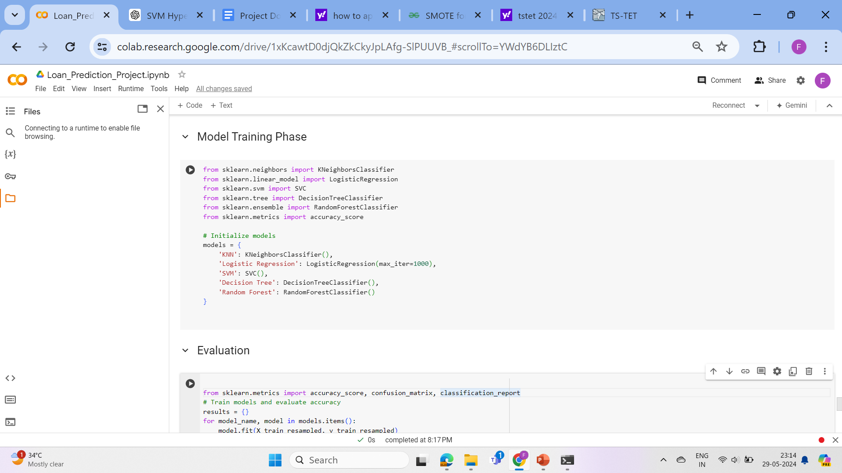
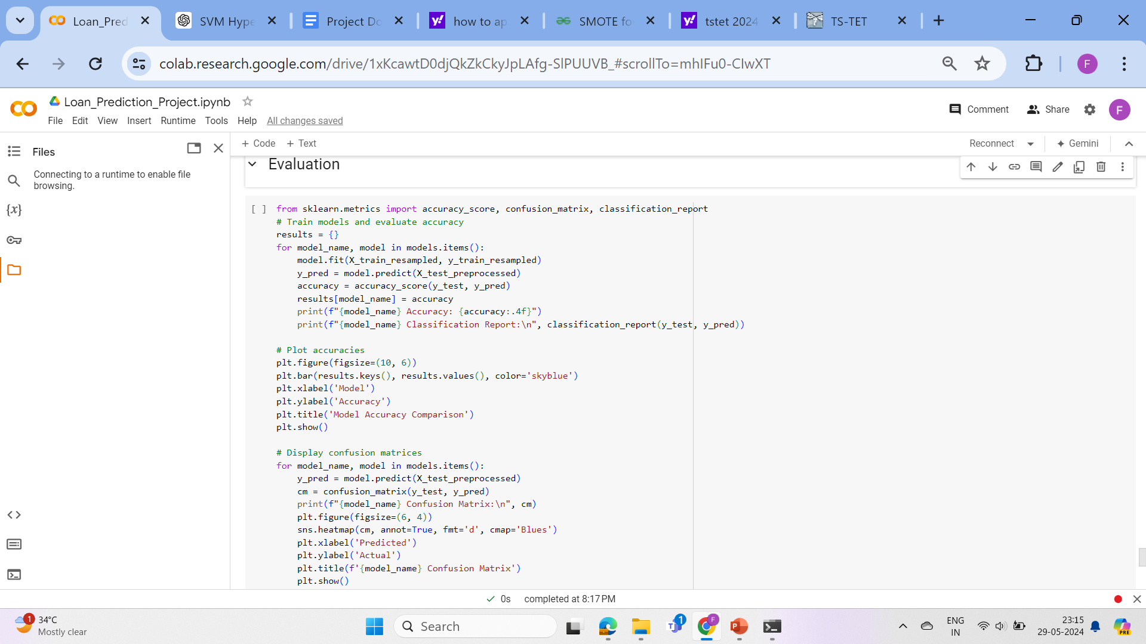

Slide 25
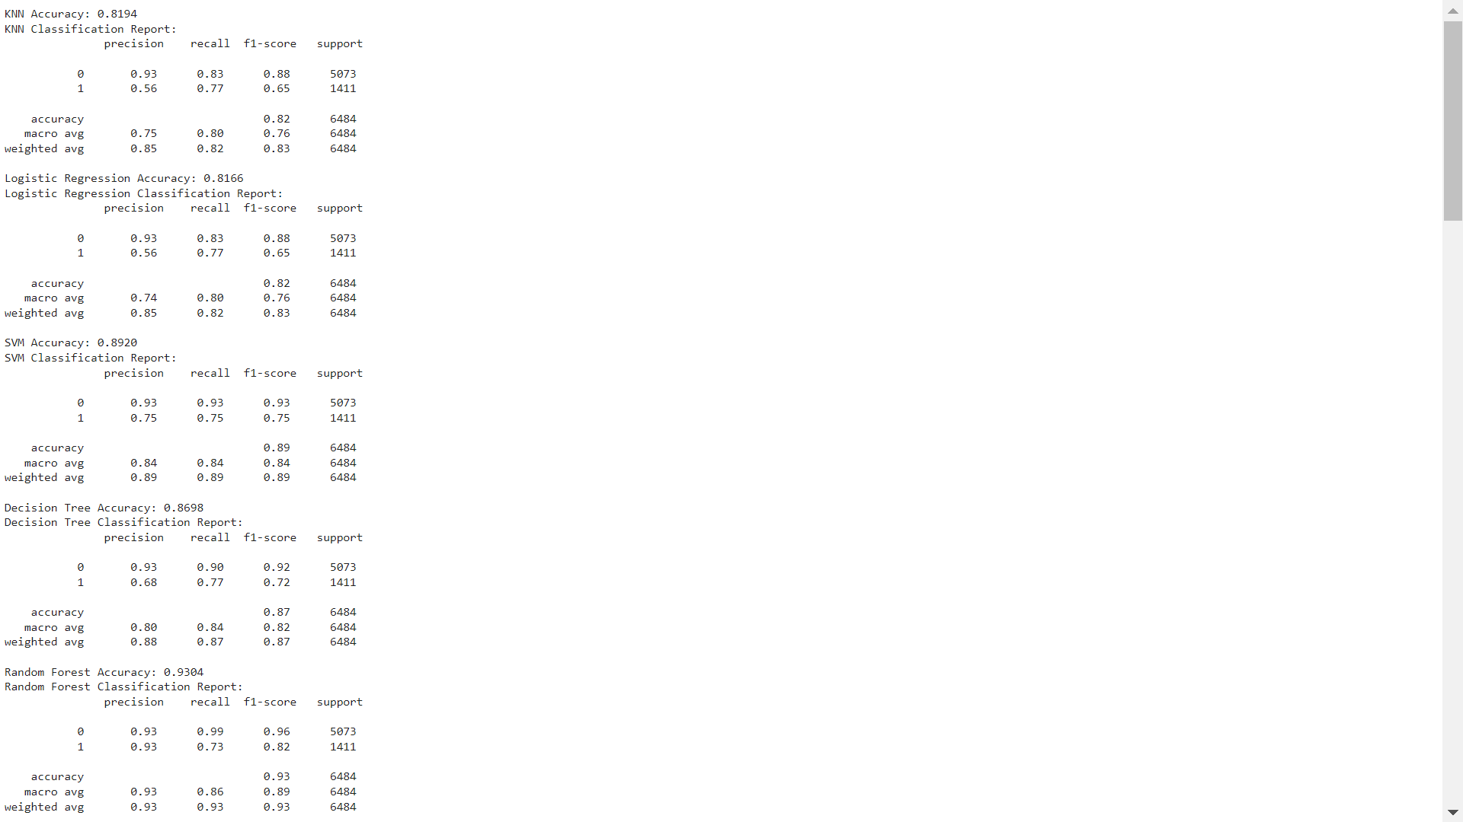
Classification Reports:
KNN (K-Nearest Neighbors):
Observations: KNN performs reasonably well, with higher precision for class 0 but lower precision for class 1. The recall rate for class 1 is relatively higher, indicating that the model can identify a larger proportion of actual positives.
Logistic Regression:

Slide 26
Observations: Logistic Regression shows similar performance to KNN, with balanced precision and recall rates for both classes.
SVM (Support Vector Machine):
Observations: SVM achieves a higher accuracy compared to KNN and Logistic Regression. It demonstrates a good balance between precision and recall for both classes.

Slide 27
Decision Tree:
Observations: Decision Tree performs well in terms of accuracy, but the precision for class 1 is relatively lower compared to other models.
Random Forest:
Observations: Random Forest achieves the highest accuracy among all models. It demonstrates high precision and recall rates for class 0, while maintaining reasonable rates for class 1.

Slide 28
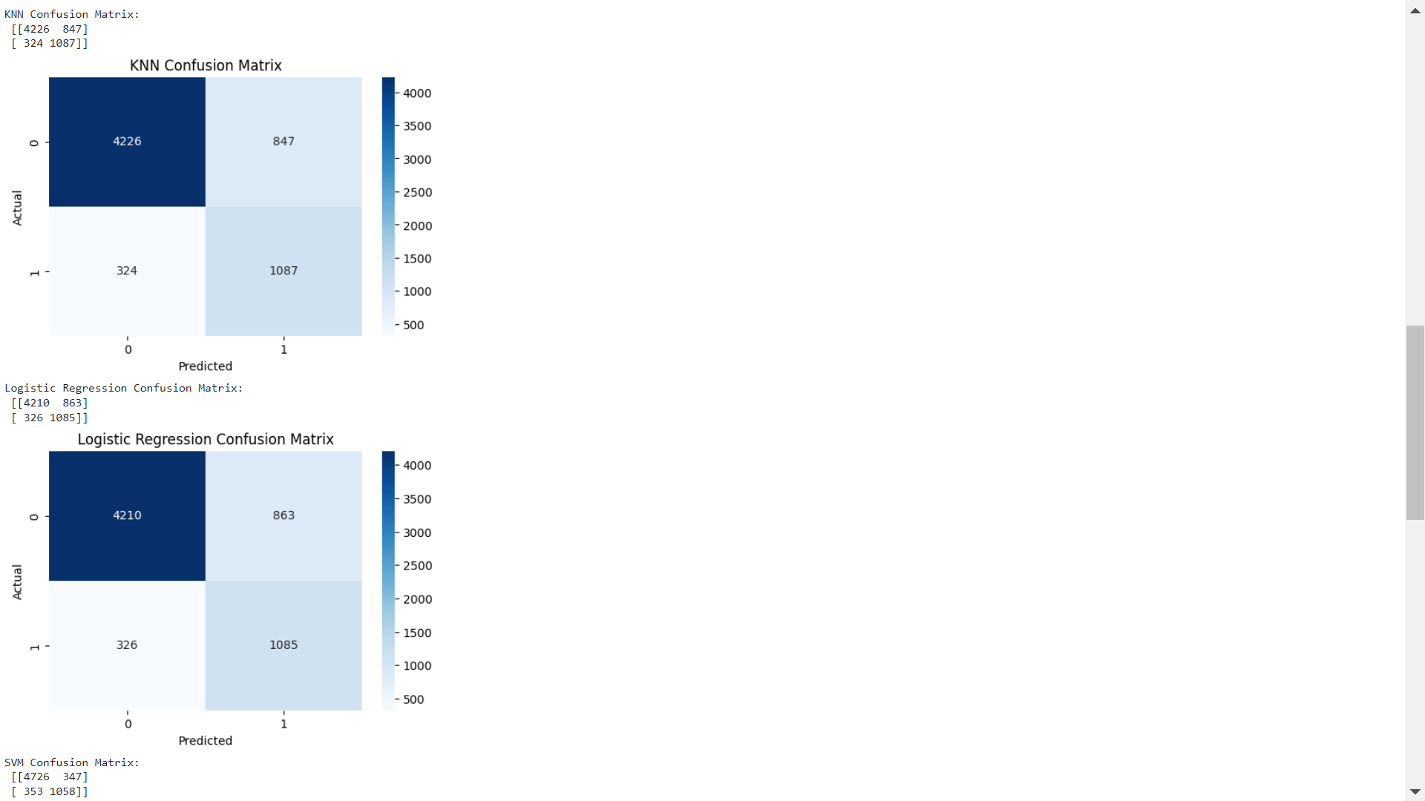
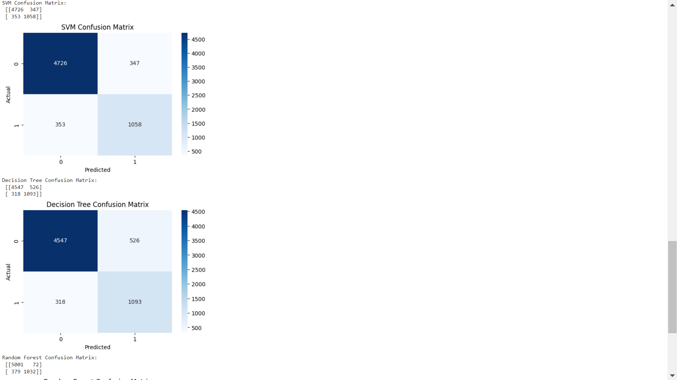
Confusion Matrices:
Each confusion matrix shows the distribution of true positive, false positive, true negative, and false negative predictions for the corresponding model. It provides a visual representation of the model's performance in classifying instances into different classes.

Slide 29
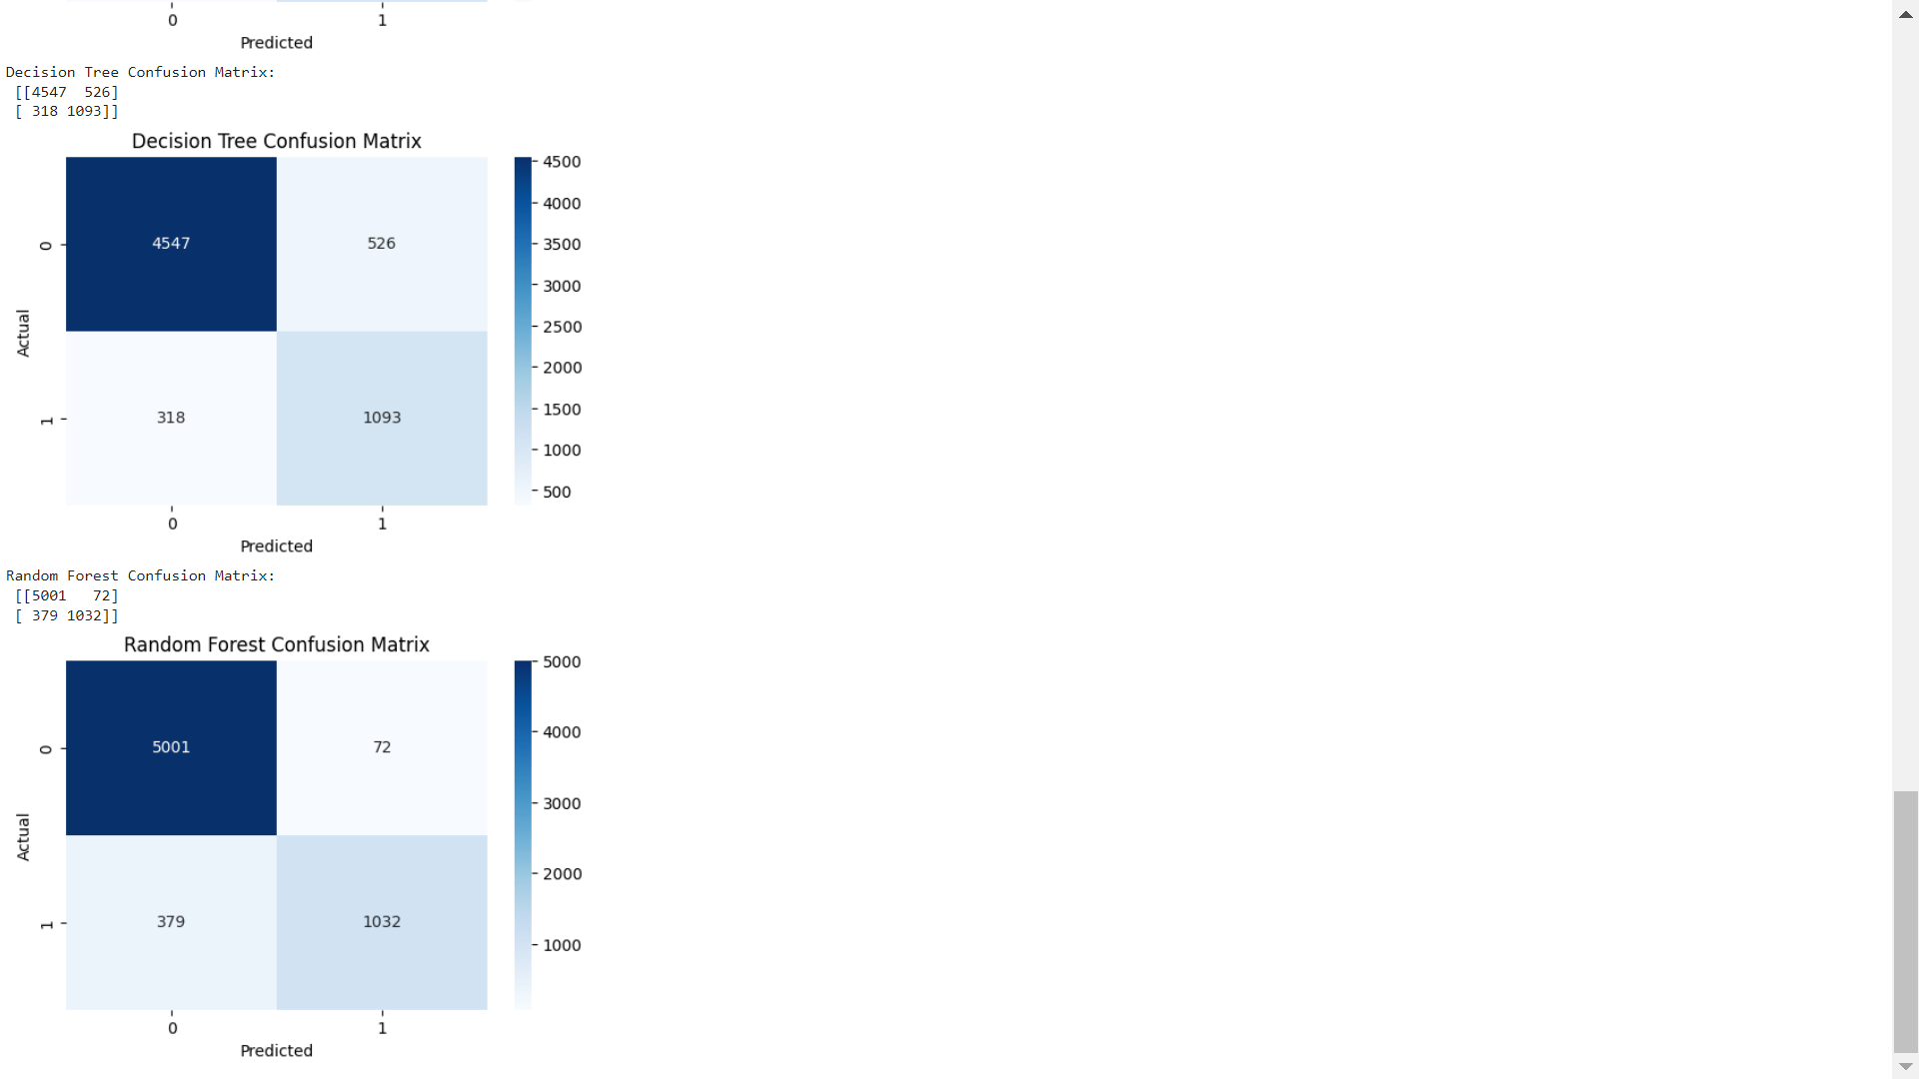
Observations:
True Negatives (TN): Highest in Random Forest, indicating it is very effective at correctly identifying instances of class 0.
False Positives (FP): Lowest in Random Forest, showing fewer instances of class 0 being incorrectly classified as class 1.
False Negatives (FN): Lowest in Decision Tree, indicating fewer instances of class 1 being incorrectly classified as class 0.
True Positives (TP): Highest in KNN, indicating it is good at correctly identifying instances of class 1, followed closely by Decision Tree and Random Forest.

Slide 30
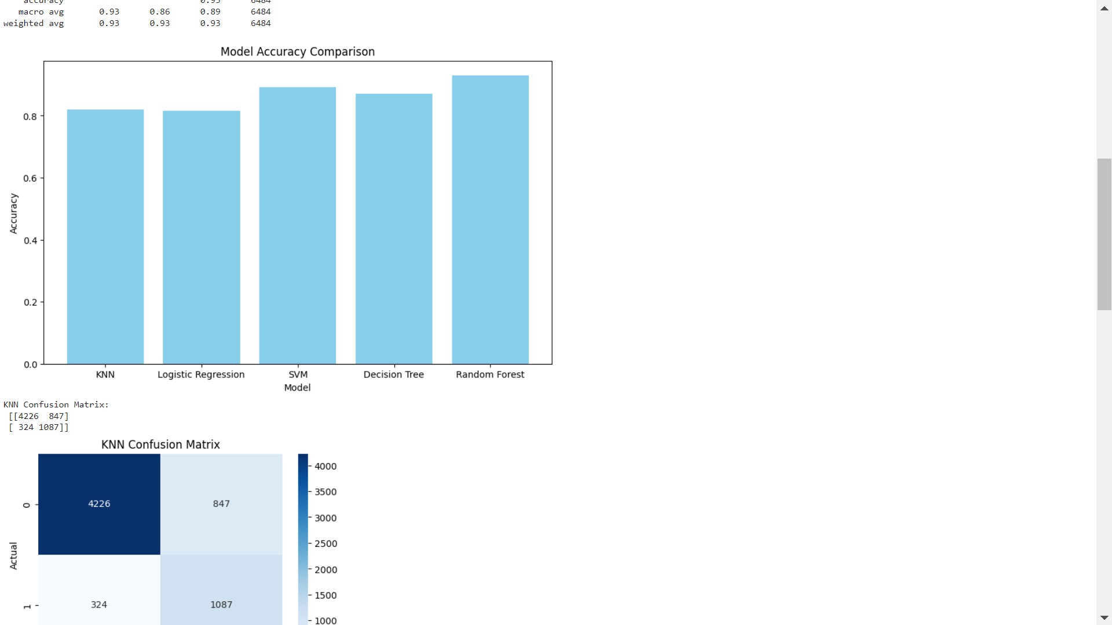
Model Accuracy Observations:
Among the models evaluated, Random Forest achieved the highest accuracy at 93.04%, demonstrating its robust performance in correctly classifying both loan approval statuses. SVM followed with an accuracy of 89.20%, showing a strong ability to distinguish between the classes, primarily due to its high true negative rate. The Decision Tree model had an accuracy of 86.98%, performing well in balancing false negatives and true positives. KNN and Logistic Regression showed similar performance, with accuracies of 81.94% and 81.66% respectively, indicating that while they are effective, they struggled more with false positives compared to Random Forest and SVM. Overall, Random Forest emerged as the most accurate model, while KNN and Logistic Regression provided comparable but slightly less effective performance.

Slide 31
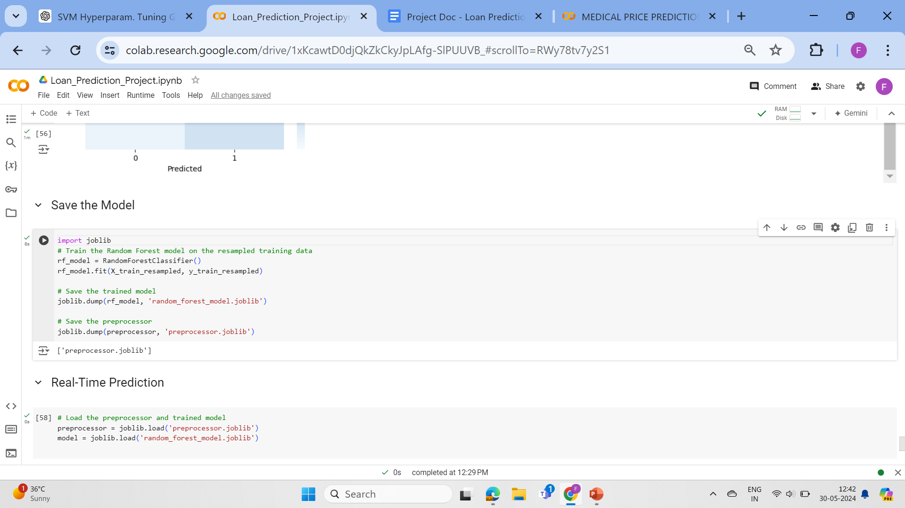
Model Training and Saving:
The Random Forest model is trained on the resampled training data to handle class imbalance.
Both the trained model (random_forest_model.joblib) and the preprocessor (preprocessor.joblib) are saved using joblib.

Slide 32
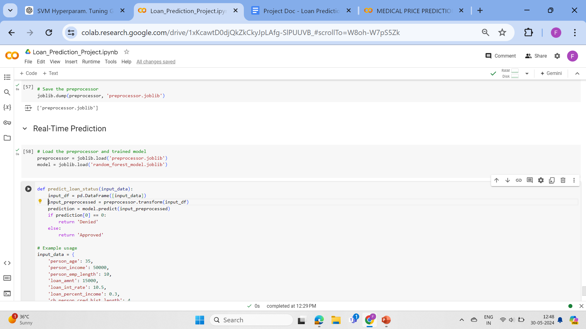
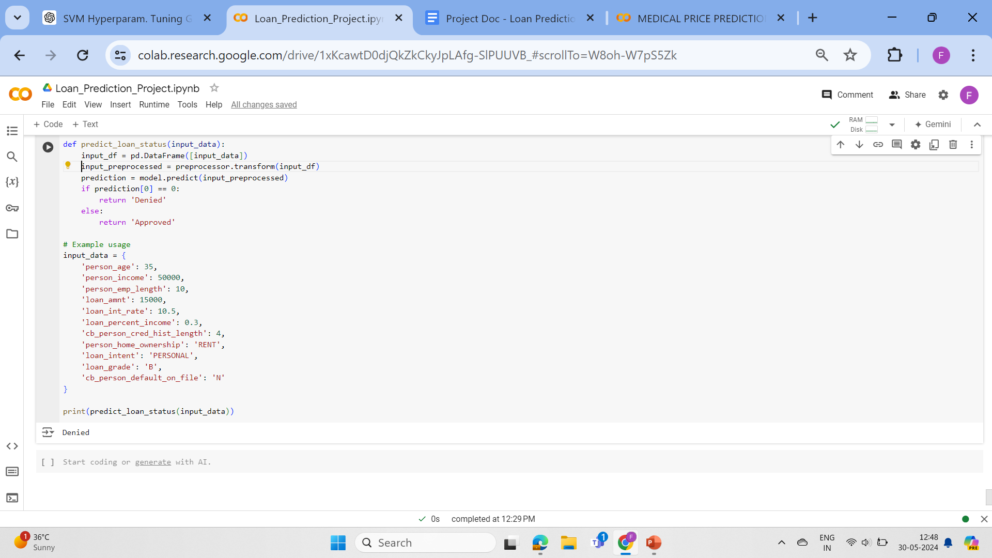
Real-Time Prediction :

Slide 33
Real-Time Prediction Function:
The predict_loan_status function loads the saved preprocessor and trained model.
It takes input data in the form of a dictionary containing the features of a loan applicant.
The input data is converted to a DataFrame and preprocessed using the loaded preprocessor.
The preprocessed data is then used to make a prediction with the loaded Random Forest model.
The prediction result is returned as either 'Approved' or 'Denied', depending on the model's prediction for the loan status.
This setup allows for efficient real-time predictions of loan approval status based on input features, aiding in quick decision-making processes in banking and lending operations.

Slide 34
Conclusions:
This project aimed to evaluate and compare various machine learning models to predict loan approval status based on applicant data, helping banks and financial institutions make more informed credit decisions. The dataset was preprocessed using scaling for numerical features and one-hot encoding for categorical features, followed by the application of SMOTE to address class imbalance. Five models were trained and evaluated: KNN, Logistic Regression, SVM, Decision Tree, and Random Forest.
Among the models, Random Forest outperformed others with an accuracy of 93.04%, highlighting its ability to handle complex relationships in the data and providing high precision and recall for both approved and default classes. SVM also showed strong performance with an accuracy of 89.20%, particularly excelling in identifying true negatives, which is crucial for minimizing loan defaults. The Decision Tree model achieved an accuracy of 86.98%, demonstrating a good balance between identifying true positives and negatives but with slightly more variance than Random Forest.

Slide 35
KNN and Logistic Regression, with accuracies of 81.94% and 81.66% respectively, showed similar performance but struggled more with false positives compared to Random Forest and SVM. KNN's performance was affected by the proximity-based classification, which can be sensitive to data distribution, while Logistic Regression, being a linear model, may not capture non-linear relationships as effectively.
The confusion matrices provided deeper insights into the models' performances. For instance, Random Forest had the lowest number of false negatives and positives, making it reliable for both identifying qualified applicants and reducing the risk of approving loans to potentially defaulting individuals. SVM's lower false positive rate is beneficial for minimizing default risks, whereas the higher false positives in KNN and Logistic Regression indicate areas for improvement.

Slide 36
In conclusion, machine learning models, particularly Random Forest and SVM, can significantly aid banks and financial institutions in assessing credit risk. These models help by providing accurate predictions of loan approval status, thereby reducing the chances of loan defaults and improving the decision-making process. Implementing these models can enhance the efficiency of credit scoring systems, leading to more reliable credit evaluations and better risk management in the banking sector. This project demonstrates the potential of machine learning in transforming traditional credit scoring into a more data-driven and precise process.

Slide 37

THANK YOU

